Slide 1

Foundational Components of Microsoft Azure Stack Hub
Azure Stack Hub Security
This work is licensed under a Creative Commons Attribution - ShareAlike 4.0 International Public License

Slide 2
Agenda
Infrastructure security
Azure Stack Hub compliance

Slide 3
Infrastructure Security

Slide 4

Traditional approach to security
Cybersecurity used to mean building
a bigger moat and a bigger wall

Slide 5
Today’s reality
“Fundamentally, if somebody wants to get in, they're getting in…accept that.”
Michael Hayden Former director of NSA & CIA
What we tell clients:
Number one,
“You're in the fight, whether you thought you were or not.”
Number two,
“You almost certainly are penetrated.”

Slide 6
Security Vision for Azure Stack Hub
Provide our customers with similar level of security and protection to Azure, while running Azure Stack Hub in hostile environments.

Slide 7
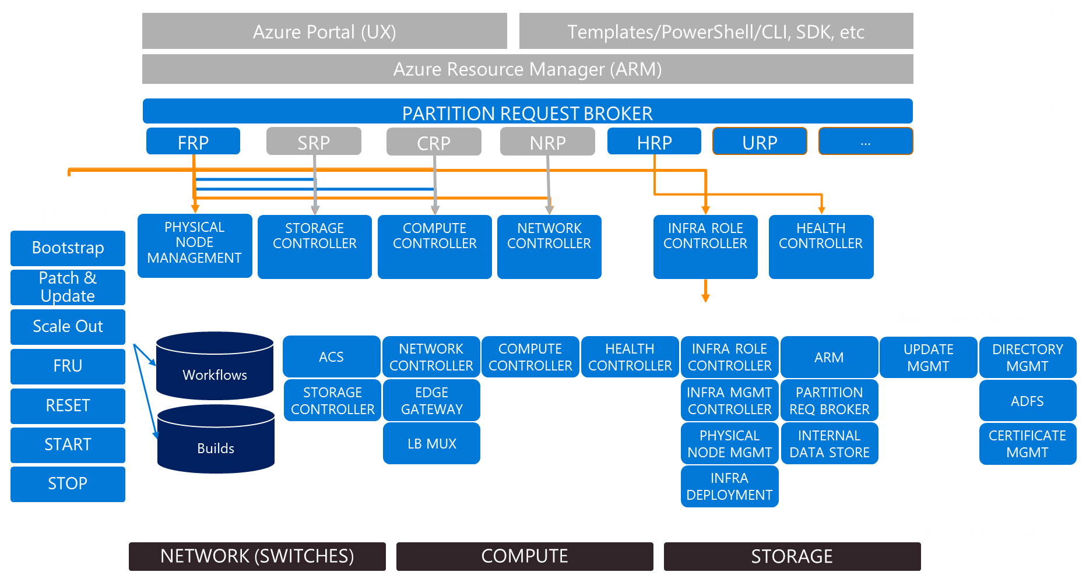
Securing Azure Stack Hub
User 1
User 2
User n
User’s responsibility:
Security posture
Management
Workload
Workload
Workload
Azure Stack Hub Infrastructure
Security posture defined by Microsoft
Hardened by Default
Assume Breach
Internals are Internal
Azure Stack Hub Operator’s responsibility:
Management

Slide 8


Hardened by Default
Production Ready
Start with step 1 of … 1000?
Instead of …

Slide 9
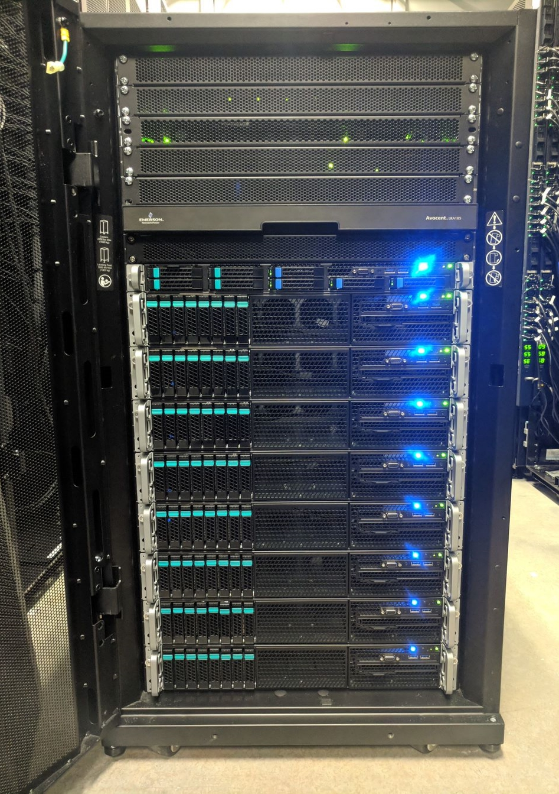
Hardware Root of Trust
Secure Boot
UEFI
TPM 2.0

Slide 10
Software Attack Surface Reduction
Hardened security OS baseline (based on DISA STIG)
Removed unused components
Windows Server 2016 security features
Code Integrity (Device Guard)
Antimalware (Windows Defender)
Network ACLs, SDN ACLs, Guest Firewall
Disabled legacy protocols (e.g. SMBv1, SSL)

Slide 11
Secrets and Sensitive Data
Hardware-rooted data at rest encryption (BitLocker + TPM 2.0)
Network encryption (TLS 1.2)
Strong authentication between infrastructure components (Kerberos, with an ‘invisible’ internal Active Directory)
Automated secrets rotation
Certificates
Internal accounts
gMSA accounts
Storage account keys

Slide 12


Assume Breach
devoting resources to detecting and limiting the impact of breaches of assets versus only trying to prevent attacks

Slide 13
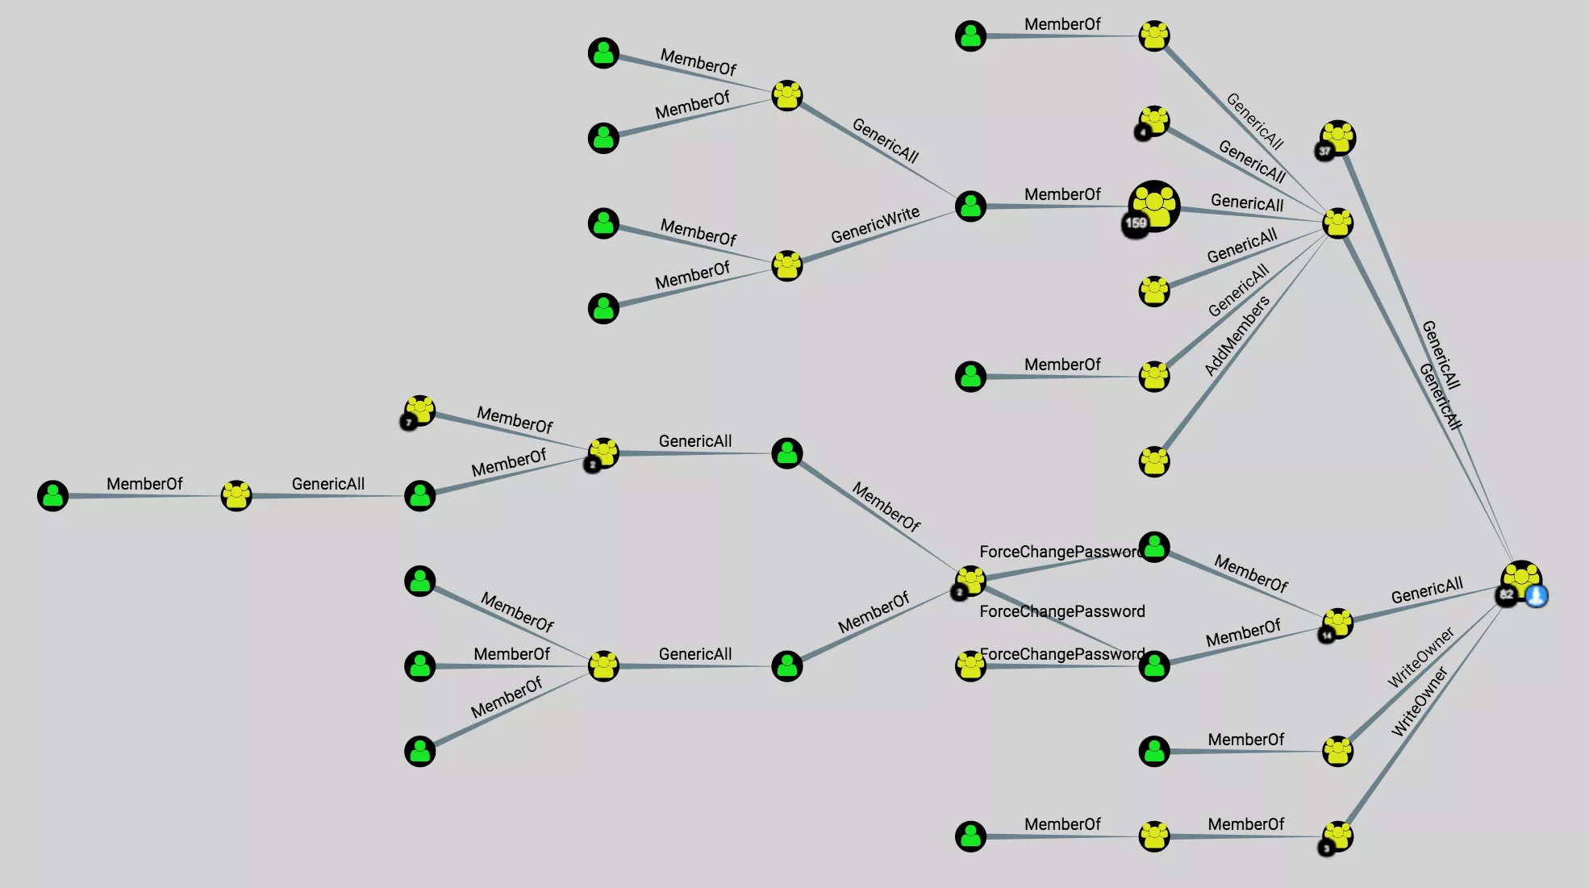
Operators, not Administrators
Admin is the most targeted role:
keys to the kingdom
Constrained operator experience
No domain admin creds
Limited interaction points
Admin Portal
ARM
Privileged Endpoint (uses PowerShell JEA) with ubiquitous transcripting

Slide 14

Security best practices
Microsoft Secure Development Lifecycle
Threat modeling of each component
Third-party penetration testing
Automatic patching and update of the entire infrastructure
Rotation of Secrets – Passwords and secrets are updated on a regular basis

Slide 15
Infrastructure Security: Benefits of a Closed System

Slide 16
Infrastructure security in a closed system
Property
Security advantages
Known deployed software and hardware
List of software components
OS dependencies/no legacy support
Known hardware characteristics
Application whitelisting
(Device Guard -> only MSFT signed)
Customized OS configuration
Data at rest encryption enabled by default

Slide 17
Infrastructure security in a closed system (2)
Property
Security advantages
Known network communication
Hosts, VMs, IPs, Ports, Protocols
Network whitelisting (ACLs at multiple layers), encryption (Bitlocker across the fabric)

Slide 18
Infrastructure security in a closed system (3)
Property
Security advantages
Predefined Admin experience
Admin roles (e.g. storage, network)
Admin access
No unconstrained admin
Just Enough Administration (JEA)
Just in Time Administration (JIT) for Privileged Endpoint (for support scenarios)

Slide 19
Infrastructure security in a closed system (4)
Property
Security advantages
Known system behavior
Known correct behaviors
Known potentially suspected behaviors
Known “who accesses what”
Aggregated events and auditing
Customized AV configurations

Slide 20
Azure Stack Hub Compliance

Slide 21


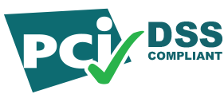

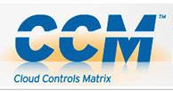
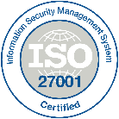
Pre-validation for compliance standards
Formal assessment of Azure Stack Hub infrastructure by 3PAO
Precompiled documentation for applicable controls for the following areas:
Technology
Infrastructure
Tenant Applications
People
Process
X
X
X
Assessment supports obtaining required certifications

Slide 22


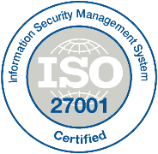

Documentation for Compliance Standards
Assessed, not certified
Download from https://aka.ms/AzureStackCompliance

Slide 23
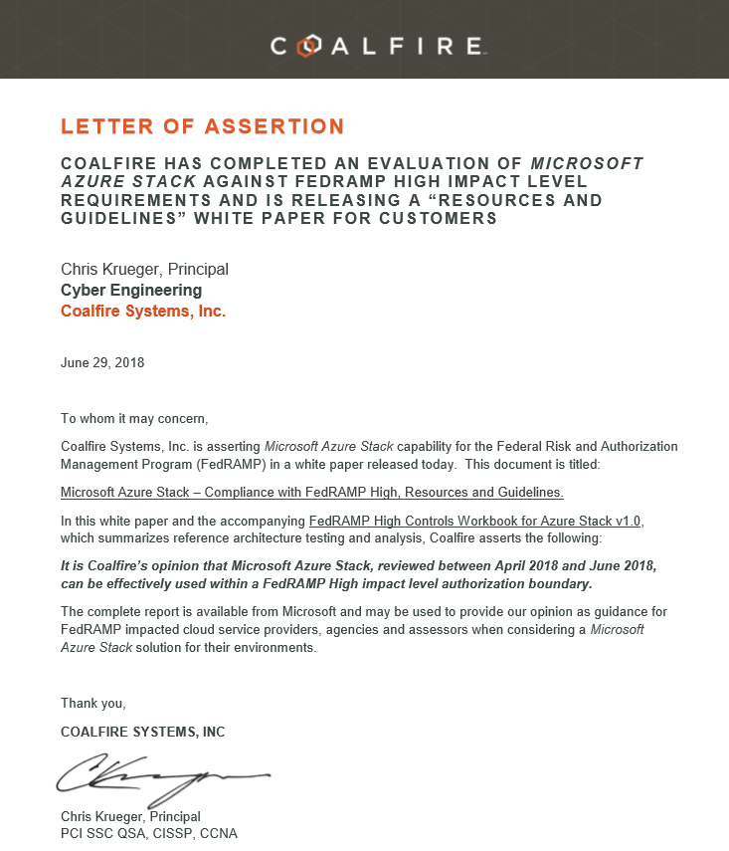
FedRAMP High assessment!

Slide 24
Auditing and intrusion detection
FedRAMP Control ID | Control Name | NIST 800-53v4 Control Description | Microsoft Azure Stack Hub Implementation Description
SI-4 (24) | Information System Monitoring | Indicators of Compromise | The information system discovers, collects, distributes, and uses indicators of compromise. | All activity on the Azure Stack Hub is logged, <…>. Logs can be collected through integration with a Security Information and Event Management (SIEM) tool with the Syslog client of Azure Stack Hub.
Announcing:
Syslog with Common Event Format payload
TLS 1.2
UDP, TCP
Mutual authentication

Slide 25
SIEM integration for Azure Stack Hub infrastructure
SIEM
HW Partner Specific
Microsoft
Switches (TOR, BMC)
Syslog Client
Infrastructure VMs
HW Partner VMs
Azure Stack Hub
Hardware Lifecycle Host
Server OS
Server OS
…
Server OS
BMC
BMC
BMC

Slide 26
SIEM integration for users’ workloads
Option 1
Option 2
SIEM
(Marketplace)
User A
User B
Workload
Workload
Agent/collector
Azure Stack Hub
SIEM (external)

Slide 27
Approaching security for Azure Stack Hub
Focus on….
Do not focus on…
Workload protection and controls
Defining role-based access control models for admins
Virtual Network security
Review network security groups and egress security
Process and procedure refinements for Azure Stack Hub
“Below the stack” items such as:
Performing platform hardening or agent-based security solutions on Azure Stack Hub Scale Unit nodes
Deep analysis of settings and configurations of fabric controller roles
Controls that require physical access to infrastructure

Slide 28
Security is a never-ending journey
Every update release
Security updates
Windows Defender updates (for disconnected)
In the coming months
TLS 1.2 only
Drift detection
More Azure Stack Hub-specific security alerts

Slide 29

Summary
Azure Stack Hub is hardened by design
Cloud-enabled security vs. traditional
Locked down infrastructure
Simplified auditing
Patch and update process

Slide 30
Questions?

Slide 32
Appendix

Slide 33
Security advantages of the cloud era
Traditional approach
Cloud-enabled security
Cloud technology enables security to:
Shift responsibilities to provider and re-allocate your resources
Leverage cloud-based security capabilities for more effectiveness
Use cloud intelligence improve detection/response/time
Large Problem Set
Limited resources available
Many unmet responsibilities
Attackers exploiting vulnerabilities at all layers

Slide 34
Customer feedback*
of interviewed customers indicated they would consider the security track record before buying the integrated solution
>90%
>75%
favor a solution that comes with hardened security settings
favor an integrated solution that comes with a set of additional security features and/or services specifically targeted and validated for that solution
>75%
*Internal survey: Data from 63 mid-size companies and enterprises, different verticals and geos

Slide 35
Customer feedback*
>70%
indicated that integrating with existing security tools was complex
indicated that security remains one of the main obstacles to overcome in order to put the system in production
>60%
#1
Compliance paperwork rated as the top frustration
*Internal survey: Data from 63 mid-size companies and enterprises, different verticals and geos

Slide 36

3rd party security software integration
Working with 3rd party security software leaders
Well-defined integration for both infrastructure and tenant space (Marketplace syndication)
Listed security products for MarketPlace Syndication can be found here

